Slide 1
HuskyADAPT REU
Joe Lawler

Slide 2
Guiding Question
How can we establish an inclusive and sustainable design program for assistive technology?
How do we ensure sustainability of projects between years?
How do we share results with the broader community?
How do we pick projects for impact?
How do we reach out to need experts for project ideas and partnerships?

Slide 3
HuskyADAPT Website
How do we ensure sustainability of projects between years?
How do we share results with the broader community?

Slide 4

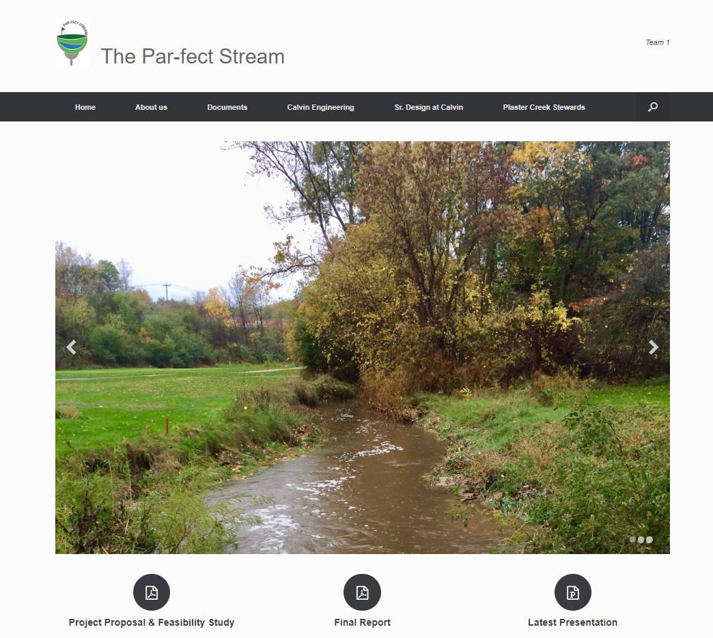
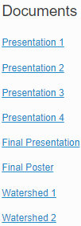
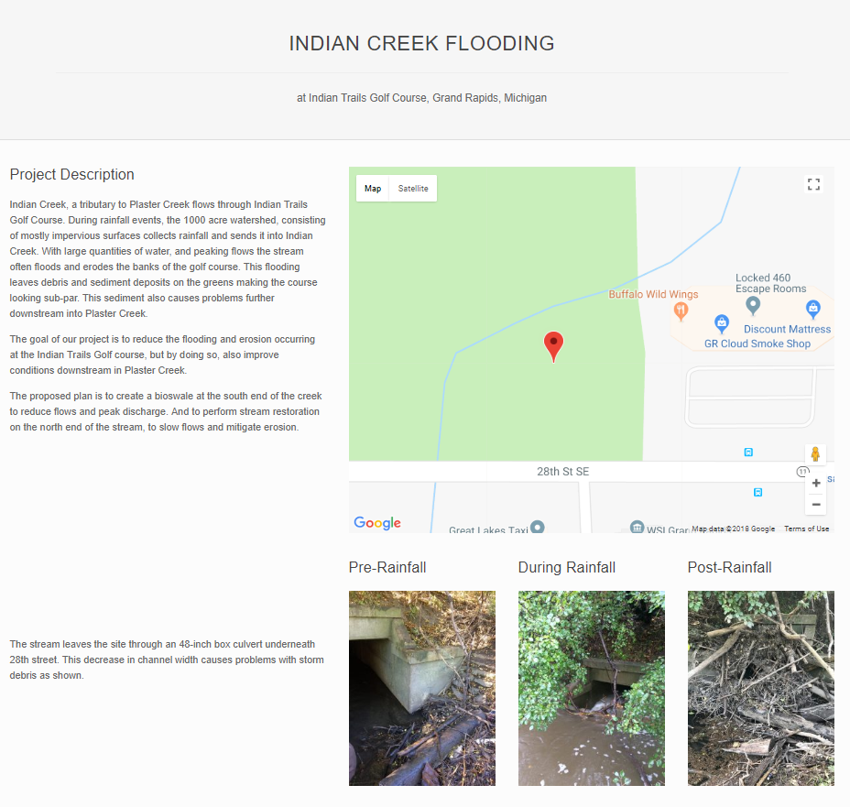
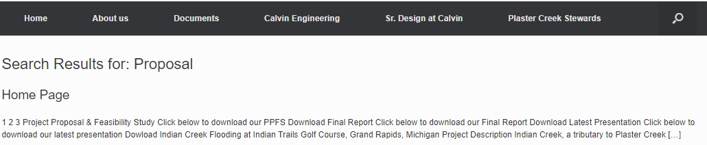
Case Study 2: The Par-fect Stream
Notes:
•Providing Contact information to members should be incorporated into our site as it encourages/enables users to reach out and find more
•Effective use of Media: not too large, still images as opposed to a slide show, and relevant to surrounding information (also use of captions)
•Having a search feature seems beneficial, the format on this site however was not optimal
•Organizing the page in a logical order is huge for retention and overall comprehension

Slide 5
What information should be posted for each team?
GOAL: Design format for presenting designs (final concept and ideas/prototypes) on the HuskyADAPT website and upload information from this year’s teams
Central page that lists all design challenges
Each Team should have their own page including:
Summary of their design challenge
Pictures
Files that people can download
Allow Community or University members to pursue similar project

Slide 6
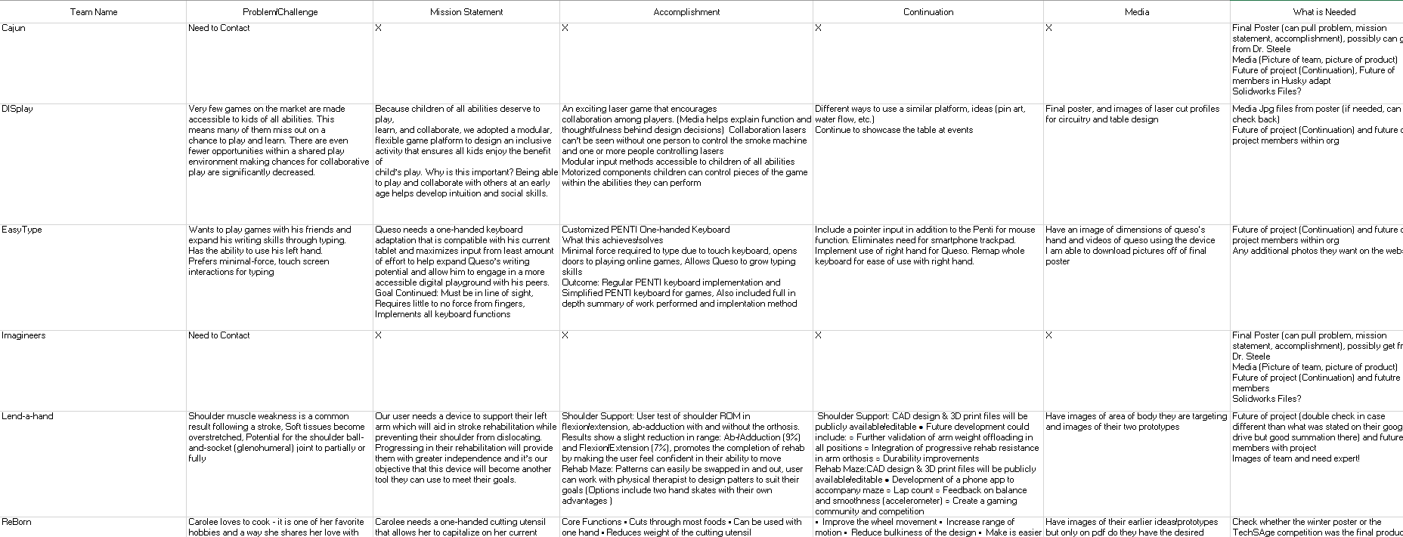
How I am compiling the Information

Slide 7
My Final Product
https://depts.washington.edu/adaptuw/wordpress/wp-admin/post.php?post=798&action=edit

Slide 8
HuskyADAPT Survey
How do we pick projects for impact?
How do we reach out to need experts for project ideas and partnerships?

Slide 9

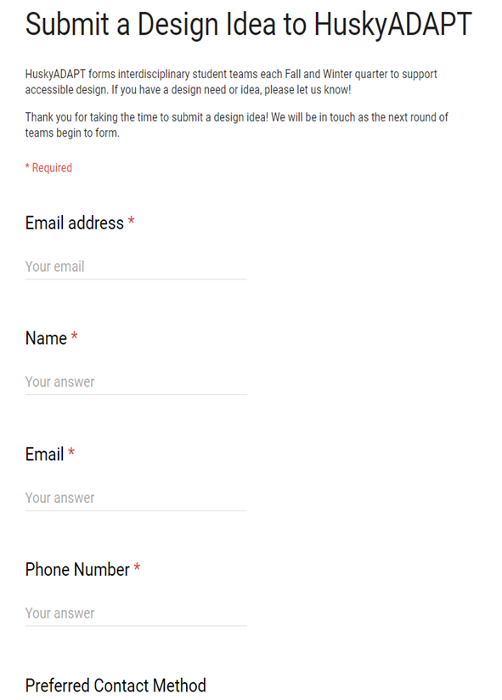



Current State of Survey
Notes:
Quick things:
-List email twice; need to correct the information on the top; add something to set expectations here

Slide 10
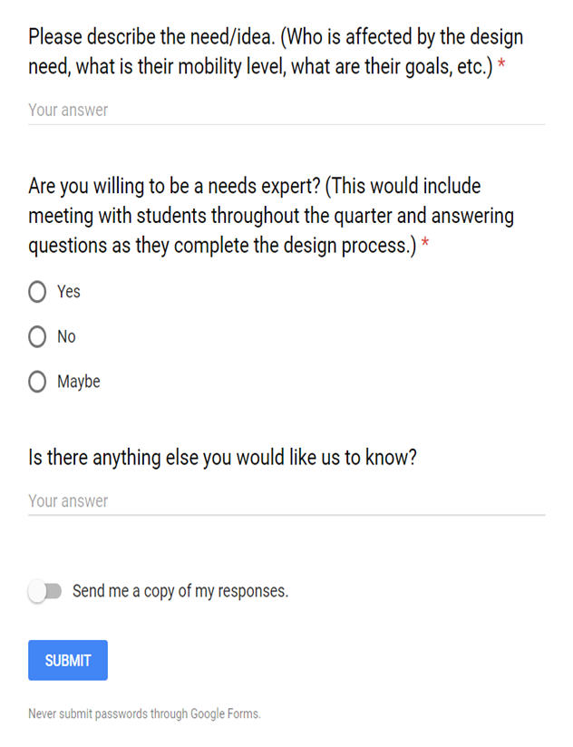
Current State of Survey
Notes:
Wanted to consider breaking down the description into multiple parts; holds user a bit more accountable to fill out info
Needs expert description is accurate but potentially limiting
Love the open ended question at the end

Slide 11
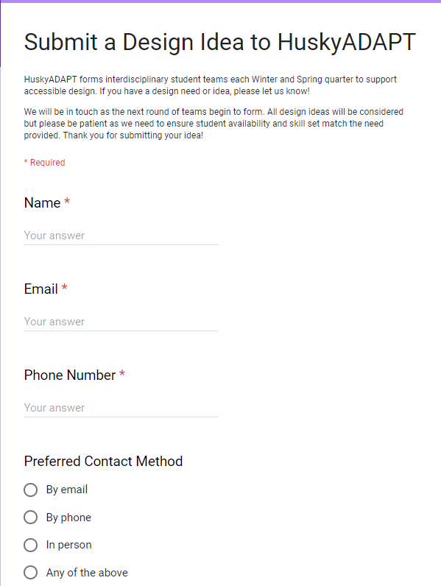
Revised Version
Notes:
Small things here:
Fixed the timeline; Set expectations on return date, wanted to be more specific but found out we couldn’t

Slide 12
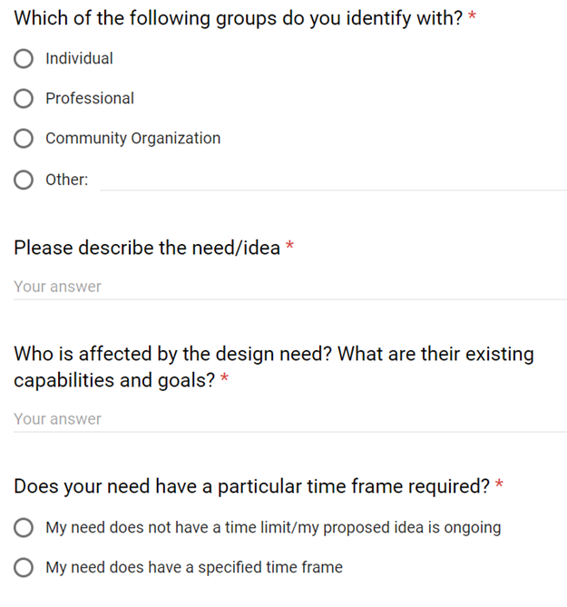
Revised Version
Notes:
The more we know about the person submitting the better
Wanted an overall description of need; asking overlapping questions should induce more detailed responses
What I really want to ask is why is this important but this is a much better way of framing it (understanding goals)
See if the idea is feasible

Slide 13
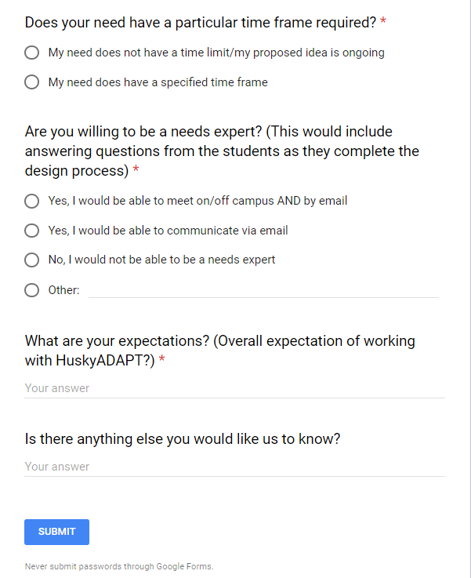
Revised Version
Notes:
This new description of a need expert is more inclusive
Biggest thing I would want to know coming in is expectations
Can manage those before even meeting with group of students; see what is achievable
Left the open ended question, like giving people the opportunity to say more

Slide 14
My own Design Project
Why I chose to push forward this project
Preliminary steps I took
Learning Java
Reviewing their documentation
Meeting with team members
What I accomplished

